Slide 1
Discrete Mathematics 2
Graphs

Slide 2
Simple Graph
Definition 1. A simple graph G = (V, E) consists of V, a nonempty set of vertices, and E, a set of unordered pairs of distinct elements of V called edges.
A simple graph is an undirected graph.

Slide 3
Undirected graphs
In undirected graphs, edges have no specific direction. Edges are always "two-way"

Slide 4
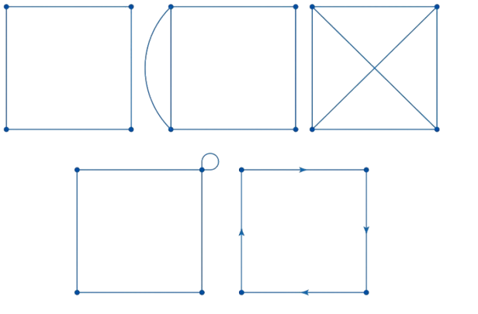
Simple graph
Which graph is simple?

Slide 5
A simple graph
What is the maximum number of edges in a simple graph G = (V, E)?

Slide 6
A simple graph
What is the maximum number of edges in a simple graph G = (V, E)?
|V| x ( |V| - 1) / 2

Slide 7
A Non-Simple Graph
Definition 2. In a multigraph G = (V, E) two or more edges may connect the same pair of vertices.

Slide 8

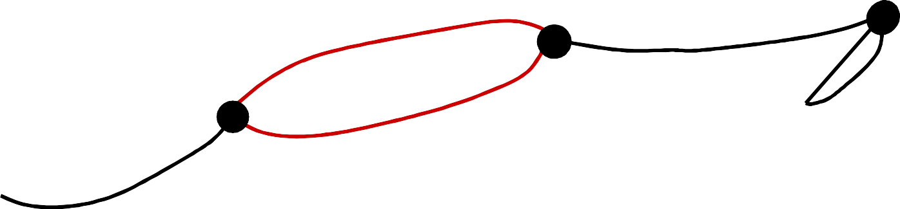



A Multigraph
THERE CAN BE MULTIPLE TELEPHONE LINES BETWEEN TWO COMPUTERS IN THE NETWORK.
Detroit
New York
San Francisco
Chicago
Denver
Washington
Los Angeles

Slide 9

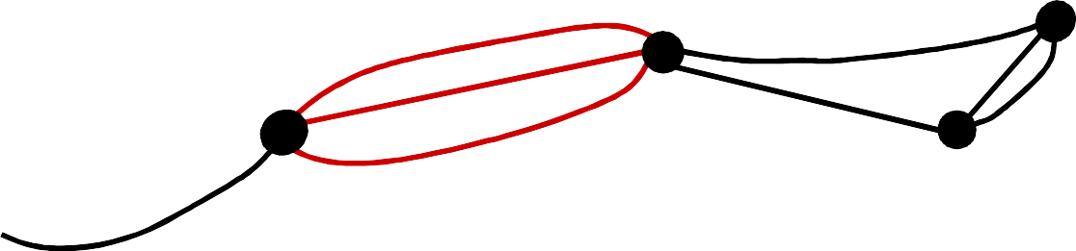


Multiple Edges
Detroit
New York
San Francisco
Chicago
Denver
Washington
Los Angeles
Two edges are called multiple or parallel edges if they connect the same two distinct vertices.

Slide 10

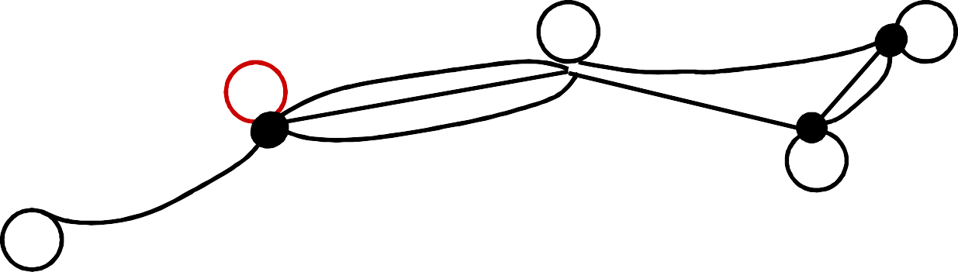



Loops
Detroit
New York
San Francisco
Chicago
Denver
Washington
Los Angeles
An edge is called a loop if it connects a vertex to itself.

Slide 11
A Directed Graph
Definition 4. In a directed graph G = (V, E) the edges are ordered pairs of (not necessarily distinct) vertices.

Slide 12
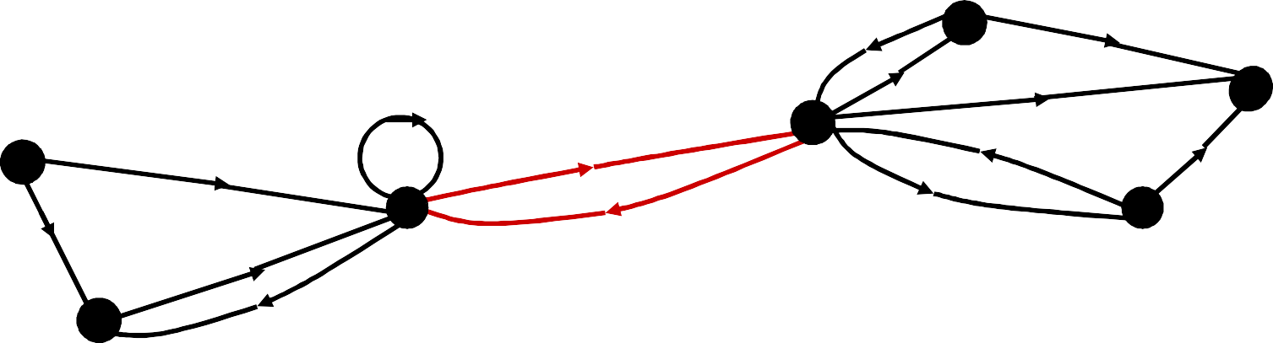
A Directed Graph
SOME TELEPHONE LINES IN THE NETWORK MAY OPERATE IN ONLY ONE DIRECTION .
Those that operate in two directions are represented by pairs of edges in opposite directions.
Detroit
New York
Chicago
San Francisco
Denver
Washington
Los Angeles

Slide 13
A Directed Multigraph
Definition 5. In a directed multigraph G = (V, E) the edges are ordered pairs of (not necessarily distinct) vertices, and in addition there may be multiple edges.

Slide 14
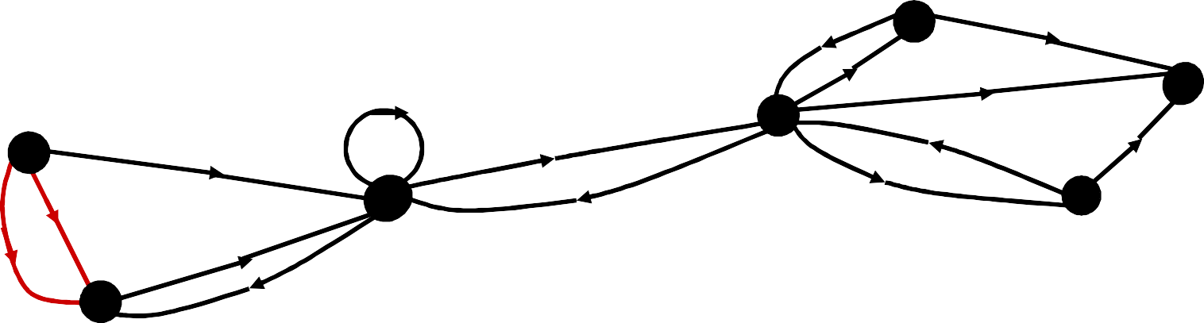
A Directed Multigraph
THERE MAY BE SEVERAL ONE-WAY LINES
IN THE SAME DIRECTION FROM ONE COMPUTER TO ANOTHER IN THE NETWORK.
Detroit
New York
Chicago
San Francisco
Denver
Washington
Los Angeles

Slide 15
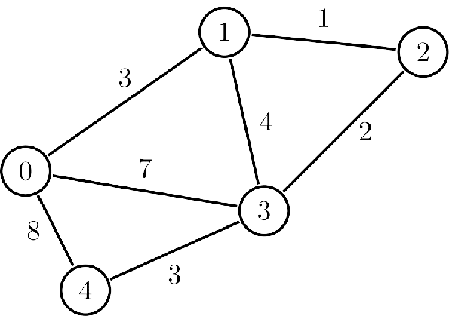
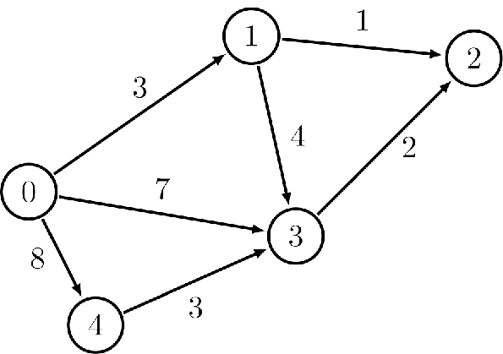
Weighted Graph
In a weighted graph, each edge has a weight or cost
Usually, the edge weights are nonnegative integers.
Some graphs allow negative weights
Notes:
The weight on edges can represent anything in the real world, for example, the amount of money to be transferred from one account to another account.
The weights can be used to represent the heat produced during a chemical reaction

Slide 16
Adjacent Vertices (Neighbors)
Definition 1. Two vertices, u and v in an undirected graph G are called adjacent (or neighbors) in G, if
{u, v} is an edge of G.
An edge e connecting u and v is called incident with vertices u and v, or is said to connect u and v. The vertices u and v are called endpoints of edge {u, v}.

Slide 17
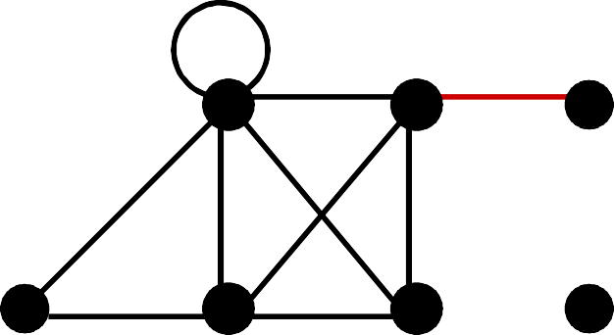
Degree of a vertex
Definition 1. The degree of a vertex in an undirected graph is the number of edges incident with it, except that a loop at a vertex contributes twice to the degree of that vertex.
c
d
deg( d ) = 1
b
a
g
f
e

Slide 18
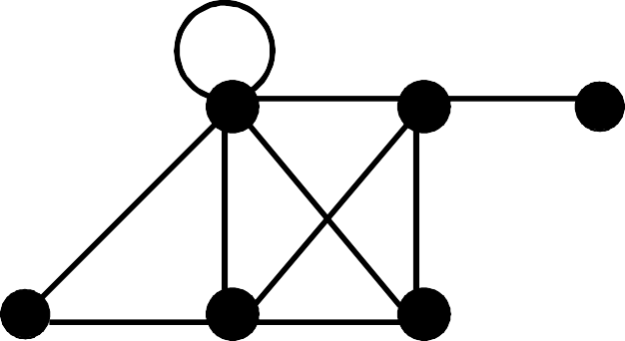

Degree of a vertex
Definition 1. The degree of a vertex in an undirected graph is the number of edges incident with it, except that a loop at a vertex contributes twice to the degree of that vertex.
c
d
b
deg( e ) = 0
a
g
f
e

Slide 19
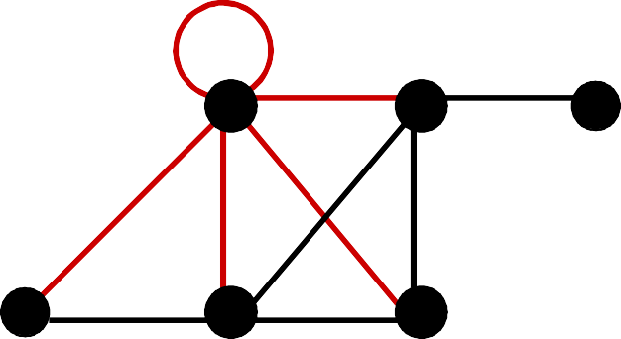
Degree of a vertex
Definition 1. The degree of a vertex in an undirected graph is the number of edges incident with it, except that a loop at a vertex contributes twice to the degree of that vertex.
c
d
deg( b ) = 6
b
a
g
f
e

Slide 20
Degree of a vertex
Find the degree of all the other vertices.
deg( a ) deg( c ) deg( f ) deg( g )
c
d
deg( b ) = 6
deg( d ) = 1
b
deg( e ) = 0
a
g
f
e

Slide 21
Degree of a vertex
Find the degree of all the other vertices.
deg( a ) = 2 deg( c ) = 4 deg( f ) = 3 deg( g ) = 4
c
d
deg( b ) = 6
deg( d ) = 1
b
deg( e ) = 0
a
g
f
e

Slide 22
Degree of a vertex
Find the degree of all the other vertices.
deg( a ) = 2 deg( c ) = 4 deg( f ) = 3 deg( g ) = 4 TOTAL of degrees = 2 + 4 + 3 + 4 + 6 + 1 + 0 = 20
c
d
deg( b ) = 6
deg( d ) = 1
b
deg( e ) = 0
a
g
f
e

Slide 23
Degree of a vertex
Find the degree of all the other vertices.
deg( a ) = 2 deg( c ) = 4 deg( f ) = 3 deg( g ) = 4 TOTAL of degrees = 2 + 4 + 3 + 4 + 6 + 1 + 0 = 20 TOTAL NUMBER OF EDGES = 10
c d
deg( b ) = 6
deg( d ) = 1
b
deg( e ) = 0
a
g
f
e

Slide 24
Degree of a vertex
An isolated vertex is a vertex of a graph that has no edges, a vertex with degree zero.
c
d
b
a
g
f
e

Slide 25
Handshaking Theorem
Theorem 1. Let G = (V, E) be an undirected graph G with e edges. Then
∑ deg( v ) = 2 e
v ε V
“The sum of the degrees over all the vertices equals twice the number of edges.”
NOTE: This applies even if multiple edges and loops are present.

Slide 26
Handshaking Theorem
Let G = (V, E) be an directed graph Then
∑deg⁻( v ) = ∑deg⁺( v ) = |E|
v ε V
“The sum of the in-degrees of all vertices is equal to the sum of the out-degrees of all vertices.”

Slide 27
Graph Terminology
Example: How many edges are there in a graph with 10 vertices, each of degree 6?
27

Slide 28
Graph Terminology
Example: How many edges are there in a graph with 10 vertices, each of degree 6?
Solution: The sum of the degrees of the vertices is 6⋅10 = 60. According to the Handshaking Theorem, it follows that 2e = 60, so there are 30 edges.
28

Slide 29
Graph Terminology
Prove that an undirected graph has an even number of vertices of odd degree.
●
29

Slide 30
Graph Terminology
An undirected graph has an even number of vertices of odd degree.
Let V1 and V2 be the set of vertices of even and odd degrees, respectively (Thus V1 ∩ V2 = ∅, and V1
∪V2 = V).
Then by Handshaking theorem
2|E| = ∑_{v∈V} deg(v) = ∑_{v∈V1} deg(v) + ∑_{v∈V2} deg(v)
Since both 2|E| and ∑_{v∈V1} deg(v) are even,
∑_{v∈V2} deg(v) must be even.
Since deg(v) if odd for all v∈V2, |V2| must be even.
●
QED
30

Slide 31
Graph Representations
Which data structure is "best" can depend on:
properties of the graph (e.g., dense versus sparse)
the common queries about the graph ("is (u ,v) an edge?" vs "what are the neighbors of node u?")
Two representations: Adjacency Matrix and Adjacency List
Different trade-offs, particularly time versus space

Slide 32
Adjacency Matrix
A simple graph G = (V, E) with n vertices can be represented by its adjacency matrix, A, where entry a_{ij} in row i and column j is
1
if { v_{i}, v_{j} } is an edge in G,
ªij
=
0
otherwise.
32

Slide 33






Finding the adjacency matrix
This graph has 6 vertices a, b, c, d, e, f. We can arrange them in that order.
c
b
d
f
a
e
W₅
33

Slide 34
Finding the adjacency matrix
TO
c
a b c d e f
FROM
a b c d e
f
0 1 0 0 1 1
b
d
f
a
e
W₅
There are edges from a to b, from a to e, and from a to f
34

Slide 35
Finding the adjacency matrix
TO
c
a b c d e f
FROM
a b c d e
f
0 1 0 0 1 1
1 0 1 0 0 1
b
d
f
a
e
W₅
There are edges from b to a, from b to c, and from b to f
35

Slide 36
Finding the adjacency matrix
TO
c
a b c d e f
FROM
a b c d e
f
0 1 0 0 1 1
1 0 1 0 0 1
0 1 0 1 0 1
b
d
f
a
e
W₅
There are edges from c to b, from c to d, and from c to f
36

Slide 37


Finding the adjacency matrix
TO
c
a b c d e f
FROM
a b c d e
f
0 1 0 0 1 1
1 0 1 0 0 1
0 1 0 1 0 1
b
d
f
a
e
W₅
COMPLETE THE ADJACENCY MATRIX . . .
35

Slide 38
Finding the adjacency matrix
TO
c
a b c d e f
FROM
a 0 1 0 0 1 1
b 1 0 1 0 0 1
c 0 1 0 1 0 1
d 0 0 1 0 1 1
e 1 0 0 1 0 1
f 1 1 1 1 1 0
b
d
f
a
e
W₅
Notice that this matrix is symmetric. That is a_{ij} = a_{ji}
Why?
38

Slide 39
Adjacency Matrix
A directed graph G = (V, E) with n vertices can be represented by its adjacency matrix, A, where entry a_{ij} in row i and column j is
1
if ( v_{i}, v_{j} ) is an edge in G,
ªij
=
0
otherwise.
39

Slide 40
Adjacency Matrix Properties
a b c d e f
Running time to:
Get a vertex’s out-edges:
Get a vertex’s in-edges:
Decide if some edge exists:
Insert an edge:
Delete an edge:
Space requirements:
Best for sparse or dense graphs?
a 0 1 0 0 1 1
b 1 0 1 0 0 1
c 0 1 0 1 0 1
d 0 0 1 0 1 1
e 1 0 0 1 0 1
f 1 1 1 1 1 0

Slide 41
Adjacency Matrix Properties
Running time to:
Get a vertex’s out-edges: O(|V|)
Get a vertex’s in-edges: O(|V|)
Decide if some edge exists: O(1)
Insert an edge: O(1)
Delete an edge: O(1)
Space requirements:O(|V|²)
Best for sparse or dense graphs? dense

Slide 42
Adjacency Matrix Properties
How can we adapt the representation for weighted graphs?
Store the weight in each cell
Need some value to represent ‘not an edge’
0, -1, or some other value based on how you are using the graph
Might need to be a separate field if no restrictions on weights

Slide 43
Adjacency List
An array of length |V| in which each entry stores a list of all adjacent vertices (e.g., linked list)

Slide 44
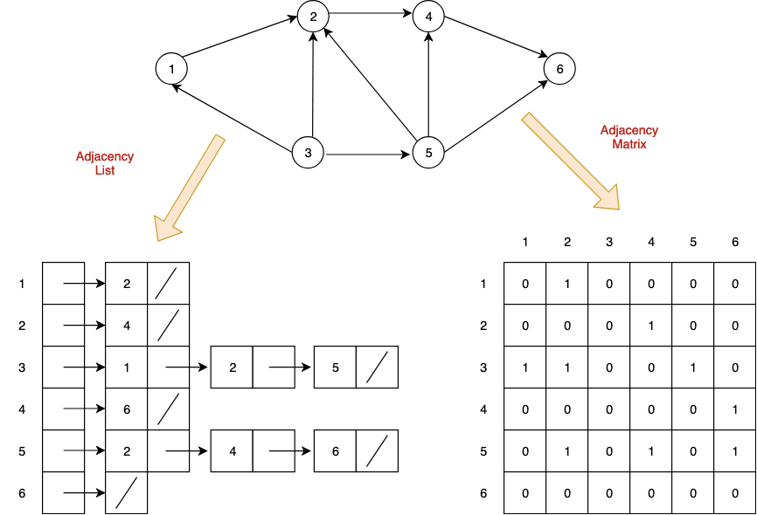
Adjacency List

Slide 45
Adjacency List Properties
Running time to:
Get a vertex’s out-edges:
Get a vertex’s in-edges:
Decide if some edge exists:
Insert an edge:
Delete an edge:
Space requirements:
Best for sparse or dense graphs?

Slide 46
Adjacency List Properties
Running time to:
Get a vertex’s out-edges: O(d) where d is out-degree of vertex
Get a vertex’s in-edges: O(|E|) (could keep a second adjacency list for this!)
Decide if some edge exists: O(d) where d is out-degree of source
Insert an edge: O(1) (unless you need to check if it’s already there)
Delete an edge: O(d) where d is out-degree of source
Space requirements: O(|V|+|E|)
Best for sparse or dense graphs? sparse

Slide 47
Undirected Graphs
Adjacency lists also work well for undirected graphs with one caveat
Put each edge in two lists to support efficient "get all neighbors"

Slide 48
Which is better?
Graphs are often sparse
Streets form grids
Airlines rarely fly to all cities
Adjacency lists should generally be your default choice
Slower performance compensated by greater space savings

Slide 49
Graph Representations
Is there any other graph representation?
Incidence Matrix

Slide 50
Subgraph
Definition 6. A subgraph of a graph G = (V, E) is a graph H = (W, F) where W ⊆ V and F ⊆ E.
50

Slide 51





C₅ is a subgraph of K₅
K₅
C₅
51

Slide 52
Union
Definition 7. The union of 2 simple graphs
G₁ = ( V₁ , E₁ ) and G₂ = ( V₂ , E₂ ) is the
simple graph with vertex set V = V₁ ∪ V₂ and edge set E = E₁ ∪ E₂ . The union is denoted by G₁ ∪ G₂ .
52

Slide 53
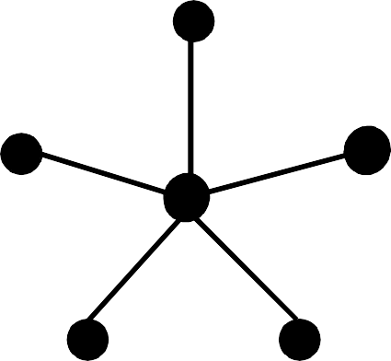
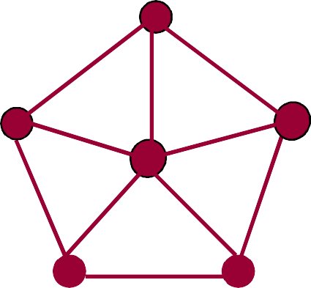





W₅ is the union of S₅ and C₅
c
c
b
d
f
a
e
c
b
d
f
S₅
a
e
b
d
W₅
a
e
C₅
28

Slide 54
Path of Length n
Definition 1. A path of length n from u to v in an undirected graph is a sequence of edges
e₁, e₂, . . ., e_{n} of the graph such that edge e₁ has endpoints x_{o} and x₁ , edge e₂ has endpoints x₁ and x₂ ,
. . .
and edge e_{n} has endpoints x_{n-1} and x_{n} , where x₀ = u and x_{n} = v.
54

Slide 55
Path of Length n
A path of length n from u to v in an directed graph is a sequence of edges
e₁, e₂, . . ., e_{n} of the graph such that edge e₁ is associated with (x₀, x₁)
edge e₂ is associated with (x₁, x₂)
. . .
and edge e_{n} is associated with (x_{n-1}, x_{n})
where x₀ = u and x_{n} = v.
55

Slide 56






One path from a to e
c
This path passes through vertices f and d in that order.
b
d
f
a
e
W₅
56

Slide 57
One path from a to a
This path passes through vertices f, d, e, in that order. It has length 4.
c
b
d
f
It is a circuit because it begins and ends at the same vertex.
a
e
It is called simple because it does not contain the same edge more than once.
W₅
57
Notes:
Trọng một số tài liệu khác:
A walk is a sequence of vertices and edges of a graph i.e. if we traverse a graph then we get a walk. Edge and Vertices both can be repeated.
Open walk- A walk is said to be an open walk if the starting and ending vertices are different
Closed walk- A walk is said to be a closed walk if the starting and ending vertices are identical
Trail is an open walk in which no edge is repeated.

Slide 58






Path of Length n
Definition 3. An undirected graph is called connected if there is a path between every pair
of distinct vertices of the graph.
c
b
IS THIS GRAPH CONNECTED?
f
a
e
W₅
58

Slide 59
Path of Length n
How to count the number of path of length n?

Slide 60
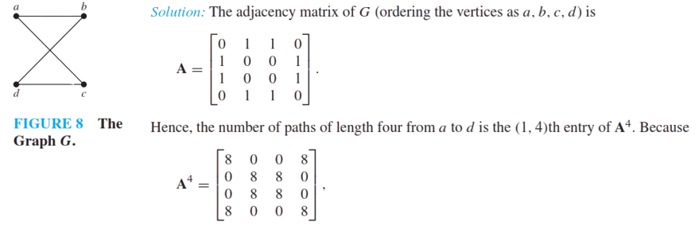

Path of Length n
How to count the number of path of length n?
Solution: Given the adjacency matrix A of the graph, the number of path of length n from vertex i to vertex j is $A^{n}\left[i\right][j$]

Slide 61
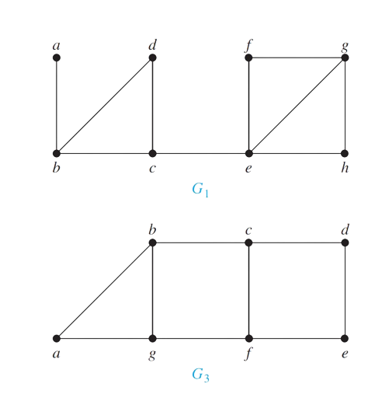
Connected Graph
There is a simple path between every pair of distinct vertices of a connected undirected graph.

Slide 62
Connected Components
A connected component of a graph G is a connected subgraph of G that is not a proper subgraph of another connected subgraph of G. That is, a connected component of a graph G is a maximal connected subgraph of G.
A graph G that is not connected has two or more connected components that are disjoint and have G as their union

Slide 63
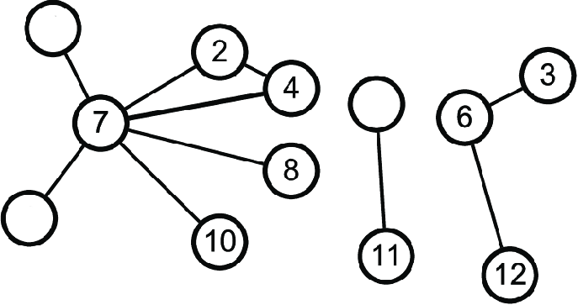
Connected Components
How many connected components are there in the following graph?

Slide 64
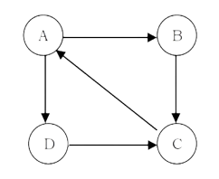
Connectedness in Directed Graphs
A directed graph is strongly connected if there is a path from a to b and from b to a whenever
a and b are vertices in the graph
Strongly connected

Slide 65
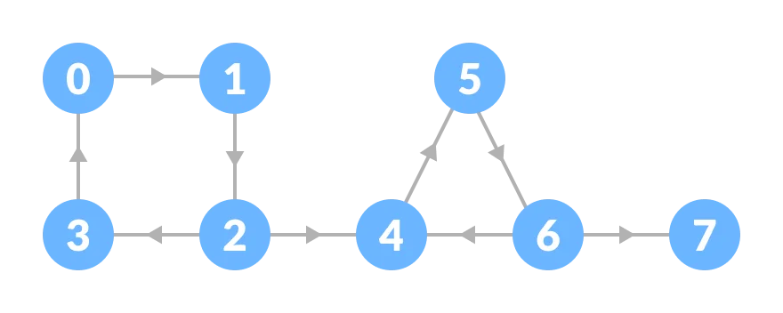
Connectedness in Directed Graphs
A directed graph is weakly connected if there is a path between every two vertices in the
underlying undirected graph.
Not strongly connected but weakly connected

Slide 66
STRONGLY CONNECTED COMPONENTS
The subgraphs of a directed graph G that are strongly connected but not contained in larger strongly connected subgraphs, that is, the maximal strongly connected subgraphs, are called the strongly connected components or strong components of G
How many?

Slide 67
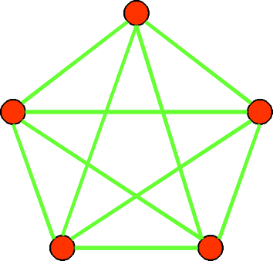


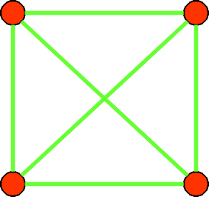




Special Graphs
Definition: The complete graph on n vertices, denoted by K_{n}, is the simple graph that contains exactly one edge between each pair of distinct vertices.
K₁ K₂
K₃
K₄
K₅
67

Slide 68




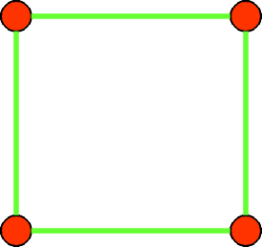






Special Graphs
Definition: The cycle C_{n}, n ≥ 3, consists of n vertices v₁, v₂, …, v_{n} and edges {v₁, v₂}, {v₂, v₃}, …,
{v_{n-1}, v_{n}}, {v_{n}, v₁}.
C₃
C₄
C₅
C₆
68

Slide 69
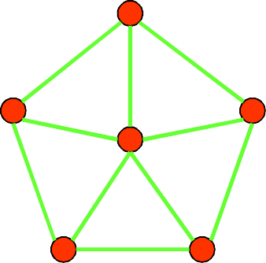
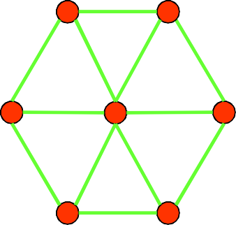
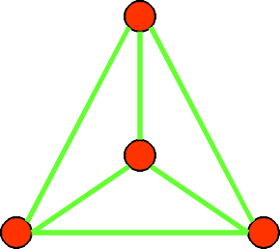
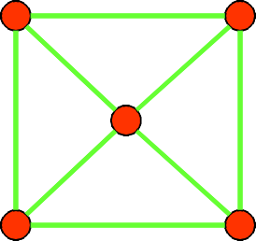
Special Graphs
Definition: We obtain the wheel W_{n} when we add an additional vertex to the cycle C_{n}, for n ≥ 3, and connect this new vertex to each of the n vertices in C_{n} by adding new edges.
W₃
W₄
W₅
W₆
69

Slide 70
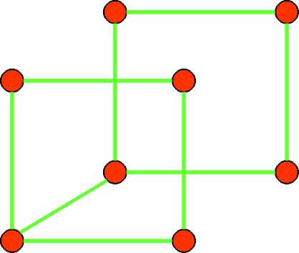

Special Graphs
Definition: The n-cube, denoted by Q_{n}, is the graph that has vertices representing the 2^{n} bit strings of length n. Two vertices are adjacent if and only if the bit strings that they represent differ in exactly one bit position.
111
110
10
11
100
101
010
011
0
1
00
01
001
000
Q₁
Q₂
Q₃
70

Slide 71
Special Graphs
Definition: A simple graph is called bipartite if its vertex set V can be partitioned into two disjoint nonempty sets V₁ and V₂ such that every edge in the graph connects a vertex in V₁ with a vertex in V₂ (so that no edge in G connects either two vertices in V₁ or two vertices in V₂).
For example, consider a graph that represents each person in a village by a vertex and each marriage by an edge.
This graph is bipartite, because each edge connects a vertex in the subset of males with a vertex in the subset of females (if we think of traditional marriages).
71

Slide 72


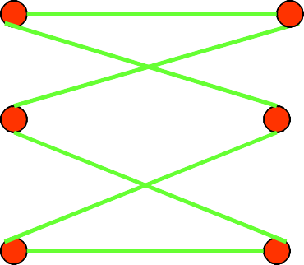
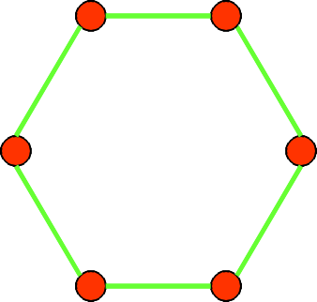
Special Graphs
Example I: Is C₃ bipartite?
No, because there is no way to
v₁
v₃
partition the vertices into two sets so that there are no edges with both endpoints in the same set.
v₂
Example II: Is C₆ bipartite?
v₁
v₂
v₁ v₅
v₃
v₆ v₂
v₄
v₆
Yes, because we can display C₆ like this:
v₅
v
v
3
4
72

Slide 73



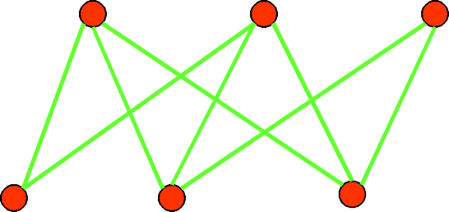



Special Graphs
Definition: The complete bipartite graph K_{m,n} is the graph that has its vertex set partitioned into two subsets of m and n vertices, respectively. Two vertices are connected if and only if they are in different subsets.
^{K}3,2
^{K}3,4
73

Slide 74

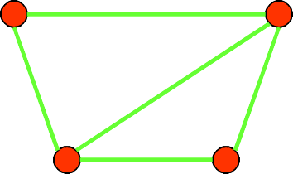
Operations on Graphs
Definition: A subgraph of a graph G = (V, E) is a graph H = (W, F) where W⊆V and F⊆E.
Note: Of course, H is a valid graph, so we cannot remove any endpoints of remaining edges when creating H.
Example:
K₅
subgraph of K₅
74

Slide 75








Euler Circuit
A Euler Circuit in a graph G is a simple circuit that includes all edges and vertices of G.
A Euler Path in a graph G is a simple path that includes all edges and vertices of G.
Visit each edge once

Slide 76
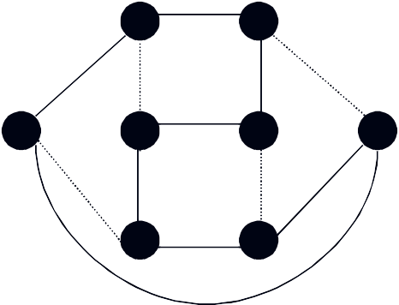









Hamiltonian circuit
… a circuit where each vertex in G is used exactly once
Visit each vertex once
b
c
c
d
e f
b
d
a
g
h
a e
Hamiltonian & Euler circuit
Hamiltonian circuit

Slide 77



Euler cycle and paths
Euler path: a path traversing all the edges of the graph exactly once
Euler cycle: a cycle traversing all the edges of the graph exactly once
Has Euler cycle
No Euler cycle no Euler path
Has Euler path, but no Euler cycle

Slide 78



Necessary and sufficient conditions for Euler cycles
Theorem 1: A connected multigraph has an Euler cycle if and only if each of its vertices has even degree.
Has Euler cycle
No Euler cycle no Euler path
C
Euler cycle??? path???
D
Has Euler path, but no Euler cycle
A
B

Slide 79




Necessary condition for Euler cycle
Theorem 1: A connected multigraph has an Euler cycle if and only if each of its vertices has even degree.
Proof Sketch, PART 1:
Assume the graph has an Euler cycle.
Observe that every time the cycle passes through a vertex, it contributes 2 to the vertex’s degree
(since the cycle enters via an edge incident with this vertex and leaves via another such edge)

Slide 80



Necessary and sufficient conditions for Euler paths
Theorem 2. A connected multigraph has an Euler path but not an Euler cycle if and only if it has exactly two vertices of odd degree.

Slide 81




Hamilton paths and cycles
Hamilton cycle: visits every vertex of the graph exactly once before returning, as the last step, to the starting vertex.
Hamilton path: visits every vertex of the graph exactly once.
Examples:

Slide 82



Hamilton paths and cycles (cont.)
No property is known to efficiently verify existence of a Hamilton cycle/path for general graphs. Moreover, the problem is known to be as difficult as the TSP (find the shortest H. cycle through n cities).
Dirac’s Theorem: If G is a simple graph with n ≥ 3 vertices such that the degree of every vertex is at least n/2, then G has a Hamilton cycle.
Ore’s Theorem: If G is a simple graph with n ≥ 3 vertices such that the deg(u) + deg(v) ≥ n for every pair of nonadjacent vertices u and v, then G has a Hamilton cycle.
Ore’s condition is more general than Dirac’s but neither is necessary for existence of a Hamilton cycle.

Slide 83

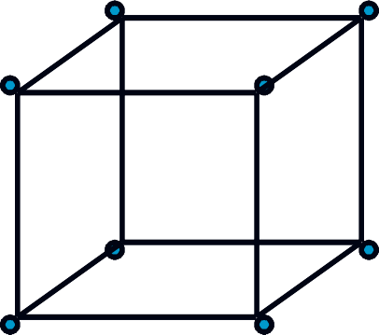
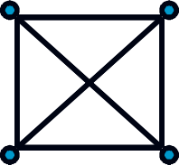
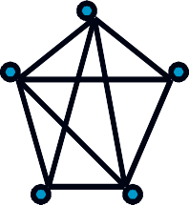

Planar graphs
A graph is planar if it can be drawn in the plane without any edges crossing
A graph that is so drawn in the plane is a plane graph.
000
001
010
011
K₄
Q₃
100
101
110
111
83

Slide 84

Plane graphs
(a) planar, not a plane graph
(b) a plane graph
(c) another plane graph

Slide 85
Planar graphs
Every plane graph has exactly one unbounded region, called the exterior region. The vertices and edges of G that are incident with a region R form a subgraph of G called the boundary of R.

Slide 86
Planar graphs
Let G be a plane graph. The connected pieces of the plane that remain when the vertices and edges of G are removed are called the regions of G.
R₃: exterior
R₁
R₂

Slide 87
Planar graphs
Every plane graph has exactly one unbounded region, called the exterior region. The vertices and edges of G that are incident with a region R form a subgraph of G called the boundary of R.
G₃
v₁
v₂
R₁
v₃
v₅
v₄
R₅
G₃ has 5 regions.
v₆
R₂
v₇
v₈
R₃
v₉
R₄

Slide 88
Planar graphs
Observe (1) Each cycle edge belongs to the boundary of two regions.
(2) Each bridge is on the boundary of only one region.
Each edge belongs to at most two regions
∑ deg( r ) ≤ 2 e
r ε G

Slide 89
Euler’s Formula
Euler’s Formula: If G is a connected plane graph with p vertices, q edges, and r regions, then p − q + r = 2.

Slide 90
Euler’s Formula
pf: (by induction on q)
(basis) If q = 0, then G ≅ K₁; so p = 1, r =1, and p − q + r = 2.
(inductive) Assume the result is true for any graph with q = k − 1 edges, where k ≥ 1.
Let G be a graph with k edges. Suppose G has p vertices and r regions.

Slide 91
Euler’s Formula
If G is a tree, then G has p vertices, p−1 edges and 1 region.
⇒ p − q + r = p – (p−1) + 1 = 2.
Hence G−e is a connected plane graph having order p and size k−1, and r−1 regions.
⇒ p - (k-1) + (r-1) = 2 (by assumption)
⇒ p - k + r = 2

Slide 92
Euler’s Formula - Consequence
If G is a connected plane graph with n (p ≥ 3) vertices, m edges
m ≤ 3n − 6.

Slide 93
Planar graph
A plane graph G is called maximal planar if, for every pair u, v of nonadjacent vertices of G, the graph G+uv is nonplanar.
If G is a maximal planar graph with p ≥ 3 vertices and q edges, then q = 3p - 6.
If G is a maximal planar bipartite graph with p ≥ 3 vertices and q edges, then
q = 2p - 4

Slide 94

Planar graph
Every planar graph contains a vertex of degree 5 or less.
pf:
Let G be a planar graph of p vertices and q edges.
If deg(v) ≥ 6 for every v∈V(G)
⇒
⇒
2q ≥ 6p →←

Slide 95

Planar graph
The graphs K₅ and K_{3,3} are nonplanar.
(1) K₅ has p = 5 vertices and q = 10 edges.
q > 3p − 6 ⇒ K₅ is nonplanar.
(2) Suppose K_{3,3} is planar, and consider any embedding of K_{3,3} in the plane.
Suppose the embedding has r regions.
p − q + r = 2 ⇒ r = 5
K_{3,3} is bipartite ⇒ The boundary of every region has ≥4 edges.
⇒
→←

Slide 96
Planar graph
A subdivision of a graph G is a graph obtained by inserting vertices (of degree 2) into the edges of G.
Two graphs G1 and G2 are called homeomorphic if they are constructed from the same graph through a sequence of divisions

Slide 97
Subdivisions of graphs.
H
G
H is a subdivision of G.
F
F is not a subdivision of G.

Slide 98
Kuratowski’s Theorem
A graph is planar if and only if it contains no subgraph that is isomorphic to or is a subdivision of K₅ or K_{3,3}.
1
1
2
3
4
5
6
10
7
2
3
4
5
6
8
9
(a) Petersen
(b) Subdivision of K_{3,3}

Slide 99



Graph Coloring
What is the least number of colors needed to color a map?
99

Slide 100

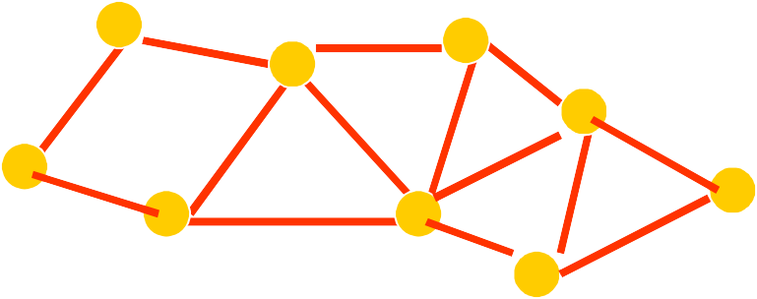


Dual Map
Region = vertex
Common border = edge
G
A
D
C
Chromatic number χ(G)
E
B
F
G
H
I
What is the least number of colors needed to color the vertices of a graph so that no two adjacent vertices are assigned the same color?
100

Slide 101
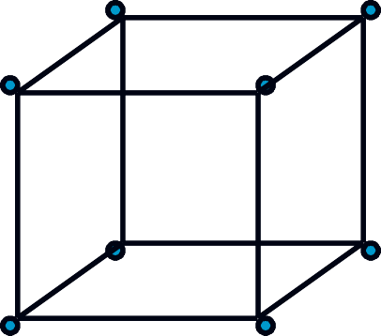
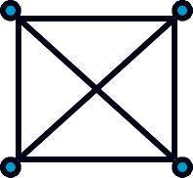
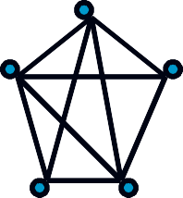


Four color theorem
Every planar graph is 4-colorable
000
001
K₄
010
011
Q₃
100
101
110
111
101

Slide 102



Chromatic Numbers (cont.)
There is no efficient algorithm for finding χ(G) for an arbitrary graph. Most computer scientists believe that such an algorithm doesn’t exist.
There is an efficient algorithm to determine whether a given graph is bipartite, i.e., 2-colorable.
Applications:
map coloring
scheduling
102

Slide 103
Graph Isomorphism

Slide 104
Graph Isomorphism
Two graphs G=(V,E) and H=(W,F) are isomorphic if there is a bijective function f: V → W such that for all v, w ∈ V:
{v,w} ∈ E ⇔ {f(v),f(w)} ∈ F

Slide 105
Variant for labeled graphs
Let G = (V,E), H=(W,F) be graphs with vertex labelings l: V → L, l’: W→ L.
G and H are isomorphic labeled graphs, if there is a bijective function f: V → W such that
For all v, w ∈ V: {v,w} ∈ E ⇔ {f(v),f(w)} ∈ F
For all v ∈ V: l(v) = l’(f(v)).

Slide 106
Complexity of graph isomorphism
Problem is in NP, but
No NP-completeness proof is known
No polynomial time algorithm is known
If P ≠ NP
NP-complete
?
Graph
isomorphism
NP
P
Notes:
NP viết tắt của: Nondeterministic Polynomial time
László Babai (2015):
Ông công bố một thuật toán chạy trong thời gian quasi-polynomial cho bài toán Graph Isomorphism.

Slide 107
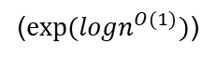
Complexity of graph isomorphism
László Babai (2015) proposed an algorithm with complexity of quasi-polynomial (not polynomial time)
(${exp⁡(logn}^{O(1)})$)
Notes:
NP viết tắt của: Nondeterministic Polynomial time
László Babai (2015):
Ông công bố một thuật toán chạy trong thời gian quasi-polynomial cho bài toán Graph Isomorphism.

Slide 108
Isomorphism-complete
Problems are isomorphism-complete, if they are `equally hard’ as graph isomorphism
Isomorphism of bipartite graphs
Isomorphism of labeled graphs
Automorphism of graphs
Given: a graph G=(V,E)
Question: is there a non-trivial automorphism, i.e., a bijective function f: V → V, not the identity, with for all v,w∈V:
{v,w} ∈ E, if and only if {f(v),f(w)} ∈ E.
Notes:
Note: the identity is a (trivial) automorphism

Slide 109
Special cases are easier
Polynomial time algorithms for
Graphs of bounded degree (Luks' Algorithm (1982))
Planar graphs (Hopcroft & Wong (1974))
Trees (tree coding, centered tree matching)
Expected polynomial time for random graphs

Slide 110
An equivalence relation on vertices
Say v ~ w, if and only if there is an automorphism mapping v to w.
~ is an equivalence relation
Partitions the vertices in automorphism classes
Tells on structure of graph

